Slide 1


2020 Autonomous Snow Plow Competition
January 16th – 18th, 2020 Minneapolis, MN
Notes:
Combine an image and multiple key statements with a strong grid.

Slide 2
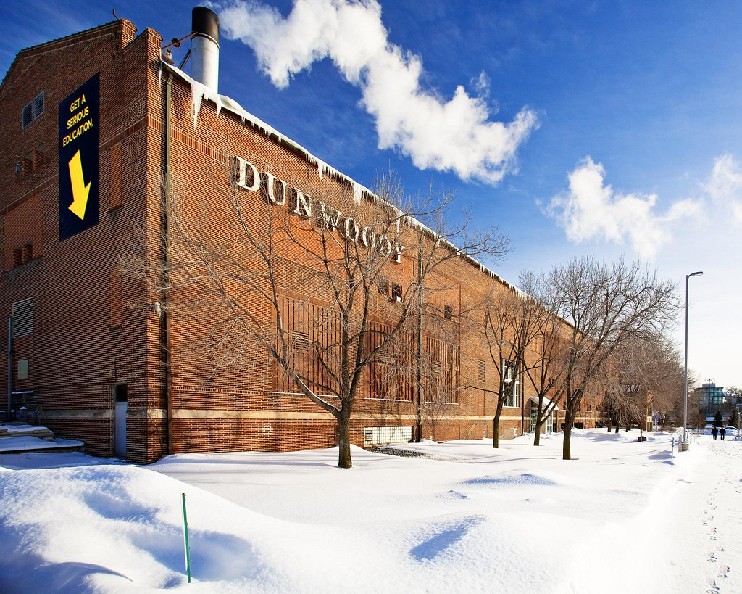
10th Annual Competition
Committee
Sponsors
Competitors
New Venue

Slide 3
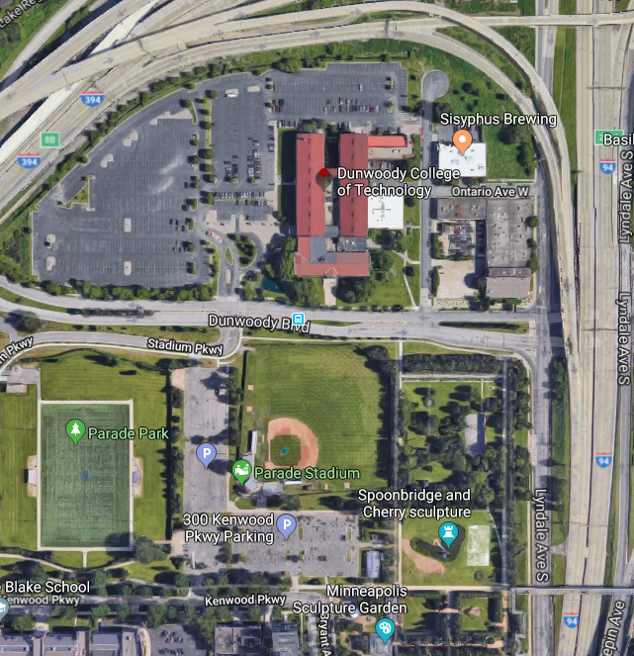

New Venue
Team Parking & Practice
Snow Plow Comp
Dunwoody College 818 Dunwoody Blvd Minneapolis, MN
Coincides with Hockey Day MN January 18th, 2020
10,000 hockey fans

Slide 4
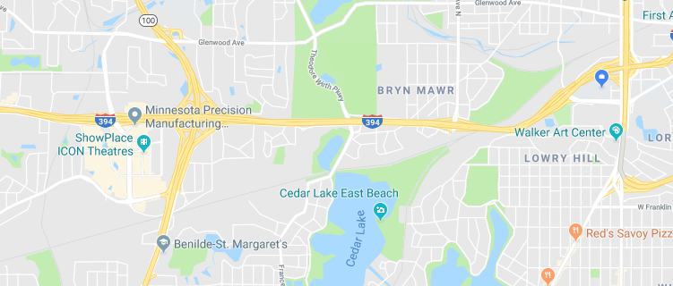
Hotels, Restaurants, etc.
The West End of St Louis Park 3.4 mile drive to Dunwoody campus
WEST END
Dunwoody College

Slide 5
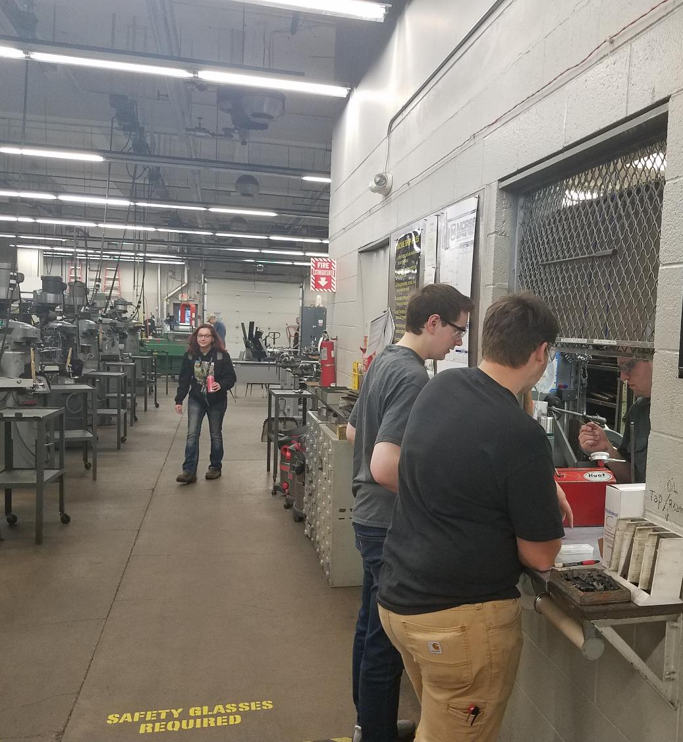
Work Space
Indoor Pits
Tool Crib
Machine Shop
Food

Slide 6
Important Dates
11/1/2019 Application Forms Due
12/7/2019 Review Status with Teams
1/16/2019 Poster Presentations
1/17/2019 Vehicle Qualification Review
1/18/2019 Single-I (8am-12pm)
1/18/2019 Triple-I (12pm-4pm)

Slide 7
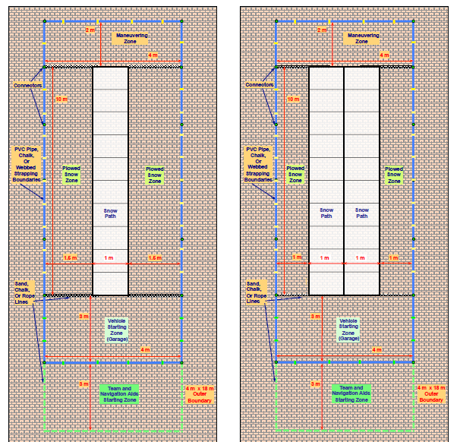
Competition Fields
Single-I
Double-I

Slide 8
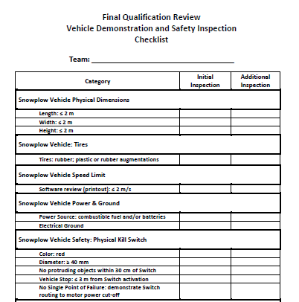
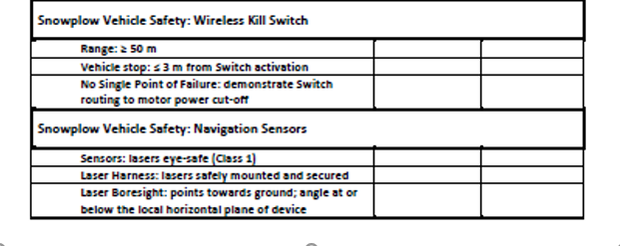
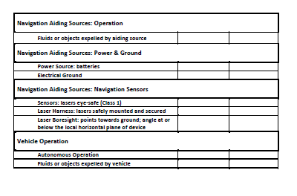
Vehicle Qualification

Slide 9

Questions

